Slide 1

Azure architectural components
Notes:
https://docs.microsoft.com/learn/modules/describe-core-architectural-components-of-azure/1-introduction

Slide 2
Core Azure architectural components – Objective Domain
Describe Azure regions, region pairs, and sovereign regions.
Describe Availability Zones.
Describe Azure datacenters.
Describe Azure resources and Resource Groups.
Describe subscriptions.
Describe management groups.
Describe the hierarchy of resource groups, subscriptions, and management groups.
Notes:
https://docs.microsoft.com/learn/modules/describe-core-architectural-components-of-azure/1-introduction

Slide 3
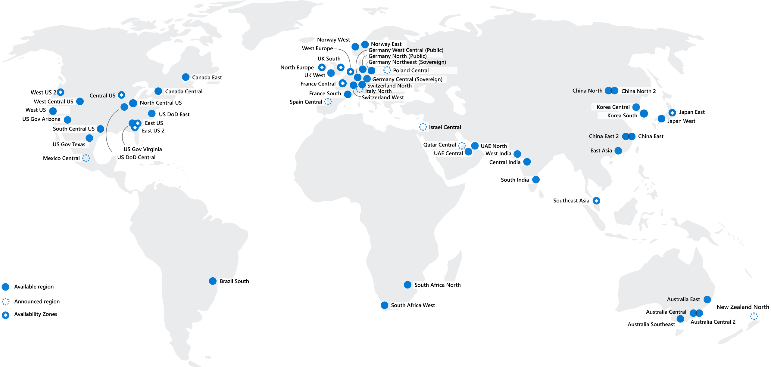
Regions
Azure offers more global regions than any other cloud provider with 60+ regions representing over 140 countries
Regions are made up of one or more datacenters in close proximity.
Provide flexibility and scale to reduce customer latency.
Preserve data residency with a comprehensive compliance offering.
© Copyright Microsoft Corporation. All rights reserved.
Notes:
https://docs.microsoft.com/en-us/learn/modules/describe-core-architectural-components-of-azure/5-describe-azure-physical-infrastructure
A region represents a collection of datacenters.
Provide flexibility and scale.
Preserve data residency.
Select regions close to your users.
Be aware of region deployment availability.
There are global services that are region independent.
A list of regions and their locations is available at https://azure.microsoft.com/en-us/global-infrastructure/locations/
Learn and SkillPipe content order note:
Slides 6-10
https://docs.microsoft.com/en-us/learn/modules/azure-architecture-fundamentals/regions-availability-zones

Slide 4
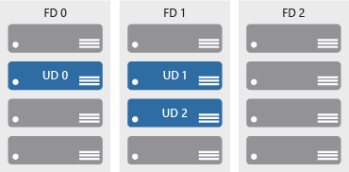

Availability zones
Azure Region
Provide protection against downtime due to datacenter failure.
Physically separate datacenters within the same region.
Each datacenter is equipped with independent power, cooling, and networking.
Connected through private fiber-optic networks.
Availability Zone 1
Availability Zone 2
Availability Zone 3
© Copyright Microsoft Corporation. All rights reserved.
Notes:
https://docs.microsoft.com/learn/modules/describe-core-architectural-components-of-azure/5-describe-azure-physical-infrastructure
Physically separate locations within an Azure region.
Takes availability sets to the next level
Includes one or more datacenters, equipped with independent power, cooling, and networking.
Acts as an isolation boundary.
If one availability zone goes down, the other continues working.
More details about Availability Zones in Azure are available at https://docs.microsoft.com/en-us/azure/availability-zones/az-overview

Slide 5
Region Pairs
Region
North Central US​
East US​
West US 2​
US East 2​
Canada Central​
North Europe​
UK West​
Germany Central​
South East Asia​
East China​
Japan East​
Australia Southeast​
India South​
Brazil South (Primary)​
Region
South Central US​
West US​
West Central US​
Central US​
Canada East​
West Europe​
UK South​
Germany Northeast​
East Asia​
North China​
Japan West​
Australia East​
India Central​
South Central US ​
At least 300 miles of separation between region pairs.
Automatic replication for some services.
Prioritized region recovery in the event of outage.
Updates are rollout sequentially to minimize downtime.
Web Link: https://aka.ms/PairedRegions
© Copyright Microsoft Corporation. All rights reserved.
Notes:
https://docs.microsoft.com/learn/modules/describe-core-architectural-components-of-azure/5-describe-azure-physical-infrastructure
Each Azure region is paired with another region.
Azure prefers at least 300 miles of separation between datacenters in a regional pair.
Some services provide automatic replication to the paired region.
In an outage, recovery of one region is prioritized out of every pair.
Azure system updates are rolled out to paired regions sequentially (not at the same time).
List of geographies, regions, region-pairs, and other details -https://azure.microsoft.com/en-us/global-infrastructure/geographies/
A full list of region pairs is available at https://docs.microsoft.com/en-us/azure/best-practices-availability-paired-regions#what-are-paired-regions

Slide 6






Azure Resources
Azure resources are components like storage, virtual machines, and networks that are available to build cloud solutions.
Virtual Machines
Storage Accounts
Virtual Networks
App Services
SQL Databases
Functions
Notes:
https://docs.microsoft.com/learn/modules/describe-core-architectural-components-of-azure/6-describe-azure-management-infrastructure

Slide 7
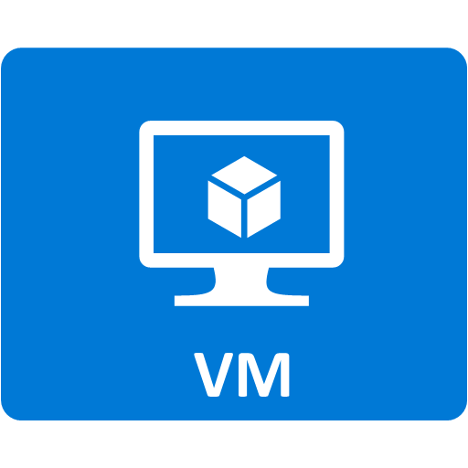


Resource groups
Resource groups (web + DB, VM, Storage) in one group
A resource group is a container to manage and aggregate resources in a single unit.
Resources can exist in only one resource group.
Resources can exist in different regions.
Resources can be moved to different resource groups.
Applications can utilize multiple resource groups.
OR
Web and DB resource group
Virtual machine resource group
Storage resource group
© Copyright Microsoft Corporation. All rights reserved.
Notes:
https://docs.microsoft.com/learn/modules/describe-core-architectural-components-of-azure/6-describe-azure-management-infrastructure
Containers for multiple resources that share the same life cycle.
Aggregates resources into a single manageable unit.
Every Azure resource must exist in one (and only one) resource group.
Secure at the resource group (or resource) level - using role-based access control (RBAC).

Slide 8
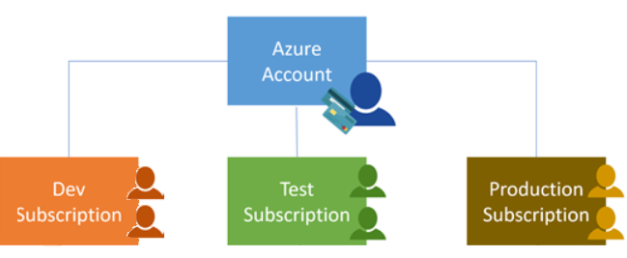
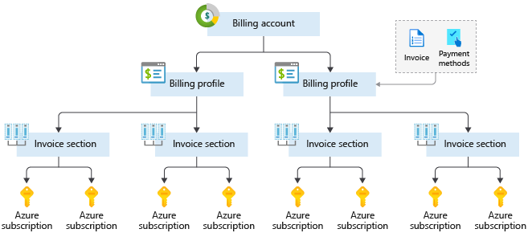
Azure Subscriptions
An Azure subscription provides you with authenticated and authorized access to Azure accounts.
Billing boundary: generate separate billing reports and invoices for each subscription.
Access control boundary: manage and control access to the resources that users can provision with specific subscriptions.
Notes:
https://docs.microsoft.com/learn/modules/describe-core-architectural-components-of-azure/6-describe-azure-management-infrastructure
An account can have one subscription or multiple subscriptions.
Azure subscription offers - https://azure.microsoft.com/en-us/support/legal/offer-details/

Slide 9
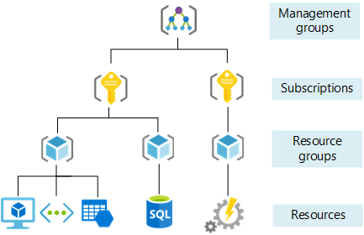
Management Groups
Management groups can include multiple Azure subscriptions.
Subscriptions inherit conditions applied to the management group.
10,000 management groups can be supported in a single directory.
A management group tree can support up to six levels of depth.
Notes:
https://docs.microsoft.com/learn/modules/describe-core-architectural-components-of-azure/6-describe-azure-management-infrastructure
Management groups can include multiple Azure subscriptions.
Subscriptions inherit conditions applied to the management group.
10,000 management groups can be supported in a single directory.
A management group tree can support up to six levels of depth.
Management groups - https://docs.microsoft.com/en-us/azure/governance/management-groups/

